Slide 1


Unlocking the Potential of Generative AI and LLMs
Embark on a journey into the transformative world of Generative AI. Explore the core concepts of Artificial Intelligence and Machine Learning. Discover the power of Large Language Models.
by Rinesh Sulendran

Slide 2


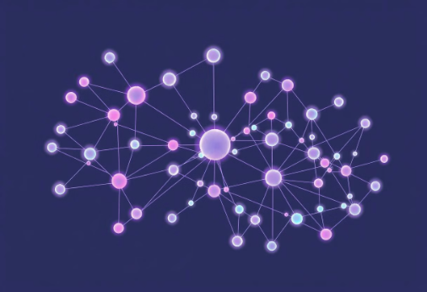
AI, ML, and Deep Learning: Laying the Foundation
Artificial Intelligence
Machine Learning
Deep Learning
AI aims to create machines that can perform tasks that typically require human intelligence.
ML algorithms learn from data without explicit programming, improving their performance over time.
DL employs neural networks with many layers to analyze data with high complexity.

Slide 3

Generative AI: Redefining Creation
1
What is Generative AI?
2
Evolution and Impact
3
Endless Possibilities
Generative AI creates new content, like text, images, and code, from learned patterns.
It has evolved rapidly. Now it impacts art, software development, and many other fields.
It offers innovative solutions. It also drives efficiency across industries.

Slide 4




Large Language Models: The Power of Text
Understanding LLMs
Global Reach
Driving Innovation
LLMs enable multilingual communication. They break down language barriers worldwide.
LLMs are trained on vast text datasets. They generate human-like text.
LLMs facilitate content creation and automation. They also improve customer service.

Slide 5




GPT-4: A Leap in AI Capabilities
Architecture
GPT-4 is built on a transformer architecture. It has increased parameters.
Enhanced Reasoning
It demonstrates advanced reasoning and problem-solving abilities.
Multimodal Input
It processes both text and images. This allows for more diverse applications.

Slide 6
Llama 3.2: An Open-Source Alternative
1
Open Source
2
Customizable
3
Accessible
Llama 3.2 provides an open-source LLM. It empowers researchers and developers. They can customize the model to meet specific needs. It fosters collaboration and innovation.

Slide 7
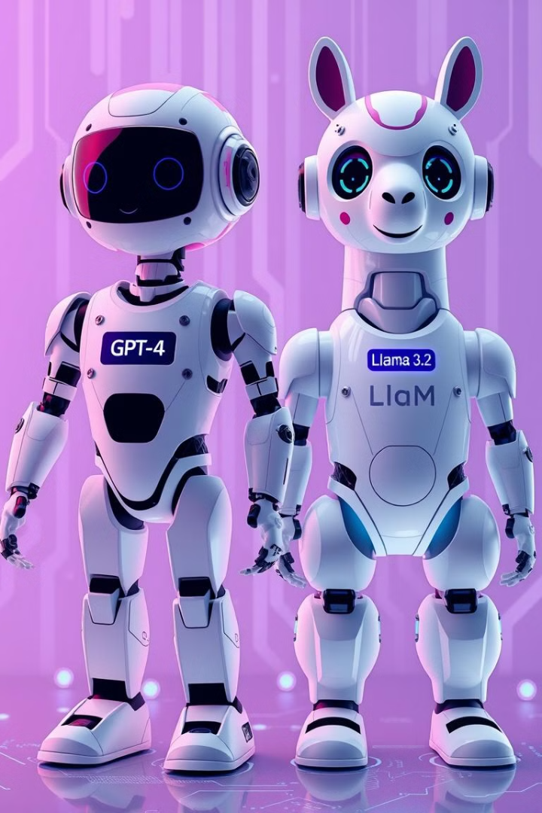
GPT-4 vs. Llama 3.2: Key Differences
Feature
GPT-4
Llama 3.2
Access
Proprietary
Open Source
Parameters
Larger
Smaller
Customization
Limited
Extensive

Slide 8



Generative AI in Software Testing: A New Era
2
Bug Detection
1
Test Case Generation
Code Analysis
3
It automates test creation. It also helps detect bugs. AI improves code analysis. This ensures software quality.

Slide 9

Applications of Generative AI in Testing
Automated Test Scripts
Smart Defect Prediction
Generates test scripts from user stories and requirements.
Identifies potential defects early in the development cycle.
Enhanced Code Coverage
Ensures thorough testing by generating diverse test cases.

Slide 10

Generative AI: Key Takeaways
AI and LLMs are transforming industries. GPT-4 and Llama 3.2 offer unique capabilities. They enhance software testing. Embracing AI drives innovation. It unlocks new possibilities.

